Slide 1
Using Machine Learning to Predict Follow-up Retention:
Next Steps

Slide 2
Machine learning (ML) briefer
Similar to statistical models, ML:
Takes data in the form of features (Predictor variables)
And predicts the target variable (Outcome variable)
May fit frequentist (mostly regression) or Bayesian models to data
As opposed to statistical models, ML:
Splits data into training and testing sets to evaluate model on unseen data
Prioritize generalizability to external data over internal validity
Primarily intended for prediction instead of hypothesis testing
Harder to interpret relationships between IVs and DV
“Tunes” model specifications across repeated fits of model to find best evaluation statistics

Slide 3
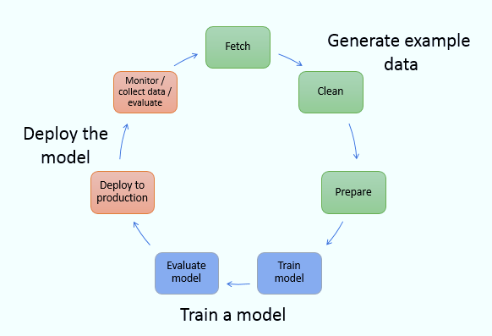
ML workflow
Data Preprocessing:
Similar to previous methods, but can be slightly different
Data Modeling:
Cross-validation
Hyperparameter tuning
Iteratively comparing fit/prediction
Selecting best fitting model
Model Deployment
Incorporating fitted model into workspace of initial problem for prediction

Slide 4
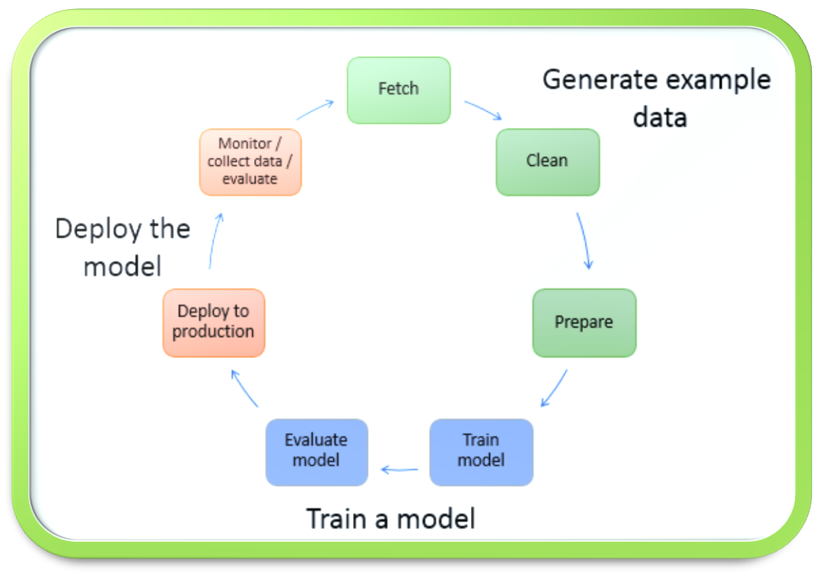
Methods
DATA
Screener (health behaviors, substance use, date of screener, recruitment source, etc)
Redcap participant data (EMA completion rates, FU label, contacts with study staff)
FEATURE EXTRACTION (list of predictors used and created)
Demographics (race, gender, education, occupational status, age)
Delay from screener to study start
Month of study start
Season of study start
Year of study start
Student Status
Alcohol/marijuana/nicotine usage
Binge behavior
Stress level
Sleep time (separated by weekday and weekend)
Sleep difference from weekday to weekend
Exercise
Fruit and Vegetable consumption
Weekly EMA completion rates

Slide 5
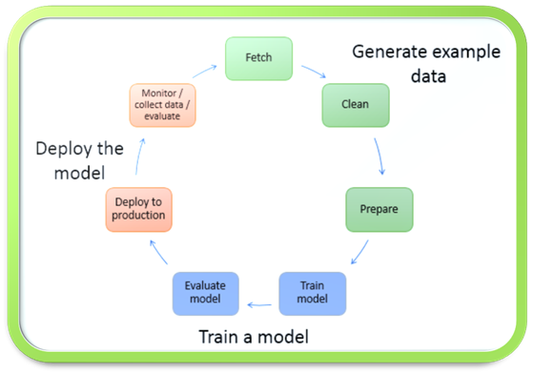

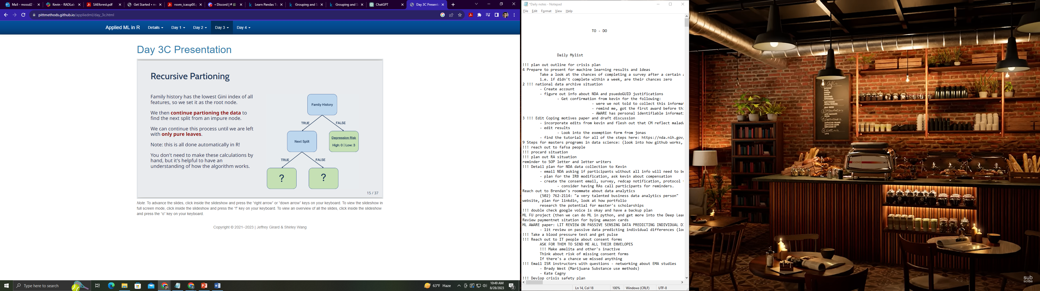

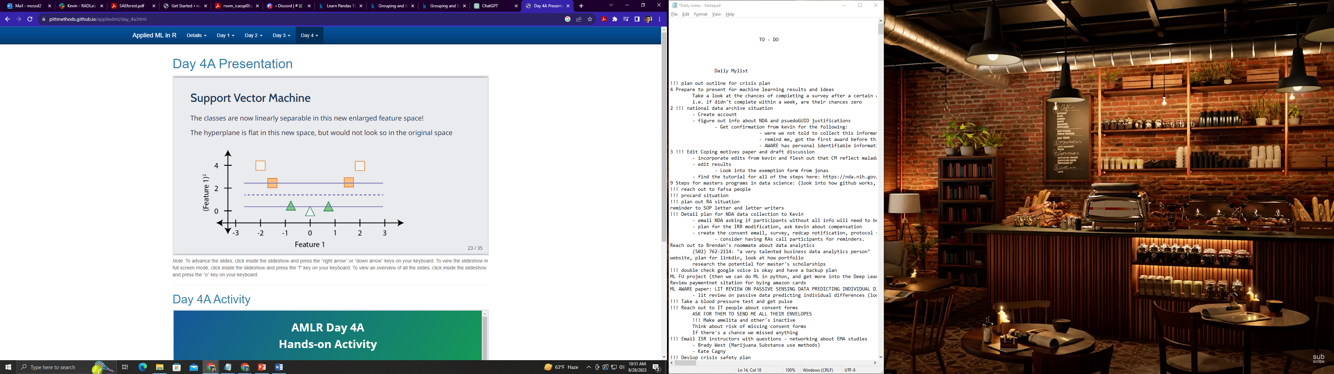
Model Selection and Training
1. Regularized regression
Regression but with penalty function for complicated models
2. Random Forest Model
Bifurcates outcome based on thresholds in the predictors
3. Support Vector Machine
Fits only the data points on the edge of a classification boundary
I use standard MLM fit and prediction to compare or see if better prediction than other models

Slide 6
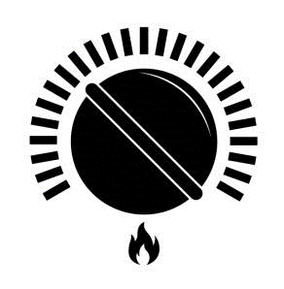
Model Fitting and Tuning
1. Regularized regression
Regression but with penalty function for complicated models
Hyperparameters
PERFORMANCE ON UNSEEN DATA
2. Random Forest Model
Bifurcates outcome based on thresholds in the predictors
3. Support Vector Machine
Fits only the data points on the edge of a classification boundary

Slide 7
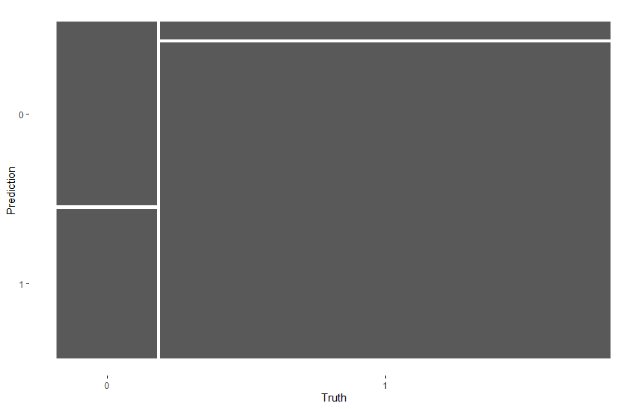
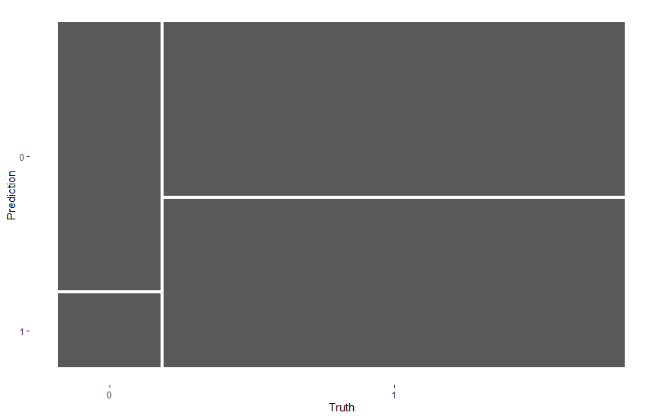
Results and tinkering
Threshold at .5
High imbalance in target variable led to overpredicting completed FUs.
18% incompletes, 82% completes
strong predictions of positives and weak prediction of negatives
55%
True Negative Rate
94.8%
True Positive Rate
Threshold at .8
But by setting a high threshold for detecting a positive, we can improve our False predictions to 78%
(i.e. since we’re overpredicting, instead of only classifying a success from probabilities higher than .5, we raise the threshold until we detect the most True negatives and least False negative)
78.3%
True Negative Rate
49.2%
True Positive Rate

Slide 8
Next steps
MLM ML models would likely fit the data more appropriately and have better rates for missing FUs, but I need to learn first.
How can we encourage upcoming at-risk participants to complete FUs?
Extra compensation? - But budget is dimishing and we’ll be paying some folks who may already take it
Extra contact? - Currently, extra FU calls and meetings have not been improving completion rates significantly
Extra Investigation? – survey these individuals to explore possible reasons for missing FUs, could be done instead with previously bad responders instead of prospectively bad responders
What other ideas do we have that could convince someone to complete a FU survey who is likely to not complete?

Slide 9
Ideas

